Slide 1
November 2019 Minneapolis AnitaB.org Event Hosted by phData Introductory Workshop on Apache Spark

Slide 2



Agenda
9:00 am Breakfast and networking
9:30 am Introduction and Message from our Event Sponsor – PhData
9:45 am Workshop
11:30 am Closing remarks and networking

Slide 3

Who We Are?
Safe Space for Women in Tech and Allies
Inclusive
Motivational
Creates Social Impact and Change
We connect, inspire, and guide women in computing, and organizations that view technology innovation as a strategic imperative.

Slide 4
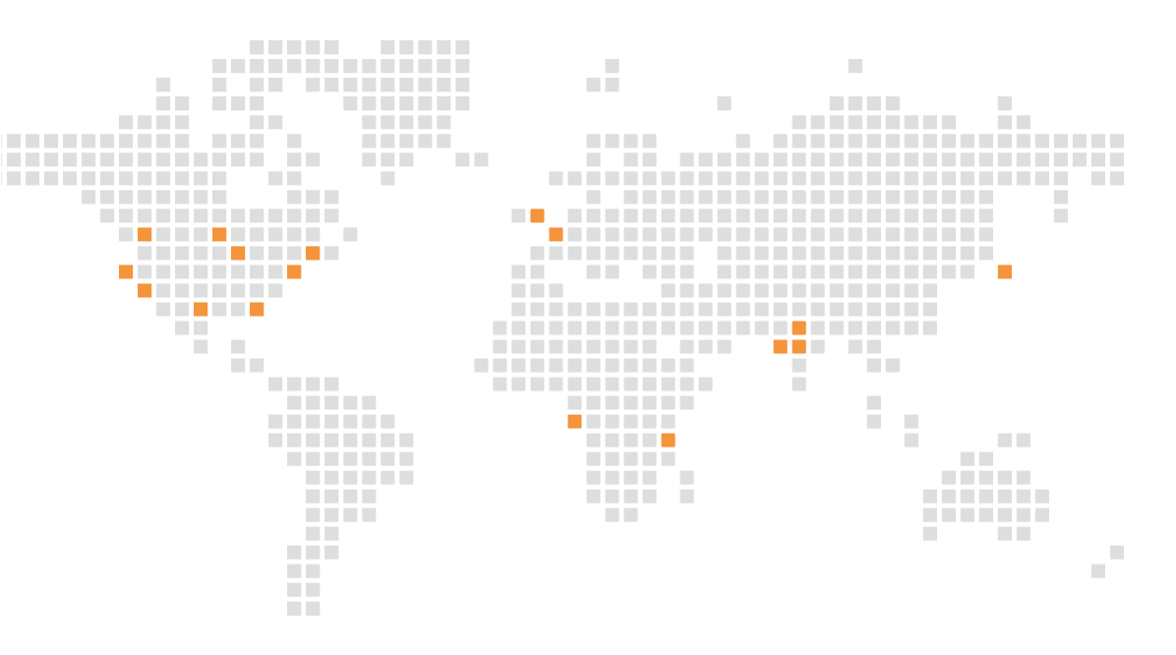
Strengthening the Local Community
A GLOBAL COMMUNITY – ANITAB.ORG LOCALS
20
LOCALS
11,080+
12 domestic, 7 international, 1 continent
Connected people on Community.AnitaB.org
TOK – Tokyo DEL – Delhi-NCR HYD – Hyderabad
PNQ – Pune
AFK – Africa NBO – Nairobi
LON – London
AMS – Amsterdam
SV – Silicon Valley LA – Los Angeles SEA – Seattle PDX – Portland ATX – Austin MSP– Minneapolis HOU – Houston CHI – Chicago ATL – Atlanta DC – Washington DC NYC – New York City BOS – Boston

Slide 5

Be Part of the AnitaB.org Community
The AnitaB.org Community is a global network that connects you with women technologists in your local area. Find support, share your stories, and explore new career opportunities.
We offer multiple ways for you to connect:
Participate in our online discussions to exchange thoughts and ideas with people in your area or from around the world.
In-person events such as workshops, codeathons, and viewing parties for our annual Grace Hopper Celebration.
Visit Community.AnitaB.org to join the Community today!

Slide 6




AnitaB Community Leaders
Tara Zieglmeier
@tarazigs
Sona Maniyan
Interested in volunteering
or hosting?
Minneapolis@communityanitab.org
Ashley Monseth
@ashleymonseth
Harpreet S.
@CommunityAnitaB #MinneapolisAnitaB

Slide 7
Thank You Sponsors!

Slide 8
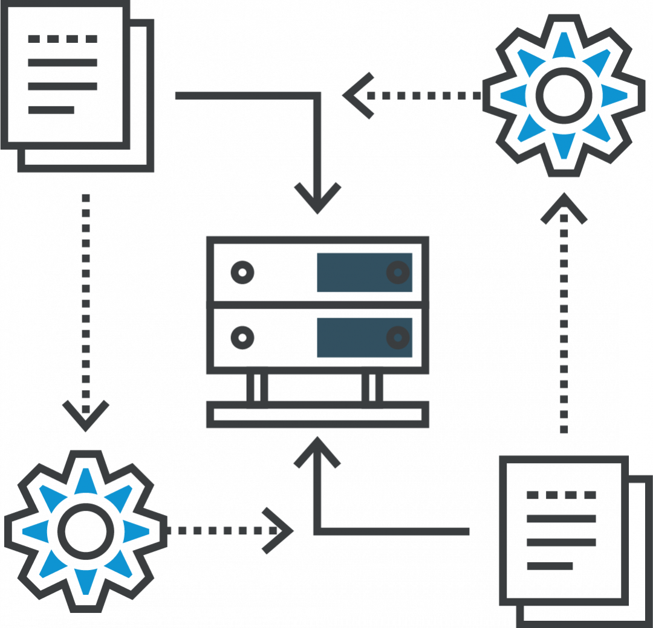
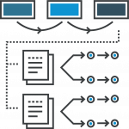

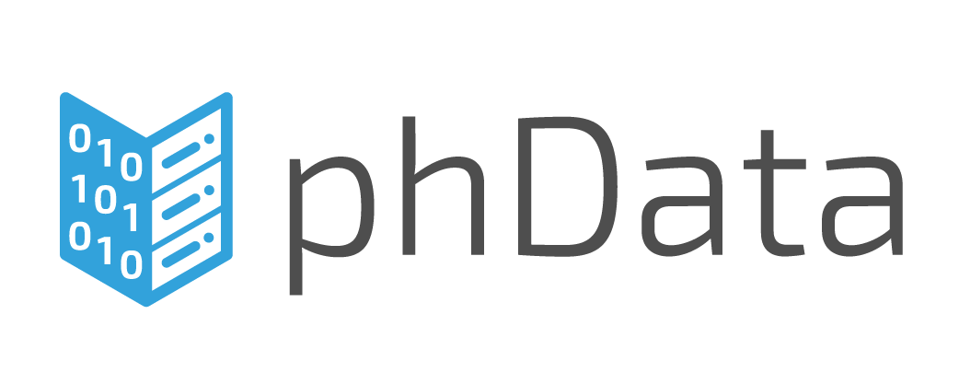
phData Services
The largest pure-play services provider for big data platforms, data engineering, and machine learning.
Data Platform Administration
Data Architecture & Engineering
Machine Learning & MLOps
Services and software to build, manage and secure your data platform, on-premises or in the cloud.
Data engineering to integrate, transform, and serve all of your enterprise data: big, medium, small, complex, structured, and unstructured.
Methodologies and expertise to perform feature engineering, model training or refitting, and model validation.
Notes:
3 different spaces

Slide 9
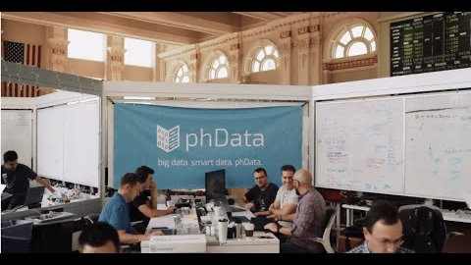

Slide 10
Introduction to Apache Spark
Sravanthi. K
Lead Data Engineer

Slide 11
Topics to be covered:
Intro to Big Data & use cases
Big Data processing tools
Apache Spark
Spark Architecture
Submit Spark Jobs
Resilient distributed datasets (RDD)
Data frames and Datasets
Tune your Spark job

Slide 12







Slide 13
Glimpse of Big Data use cases
Web display advertising and competitive analysis
Social media and sentiment analysis
Real-time fraud detection
Intelligent traffic management
Analytics for new product launch
Personal Quantification `
IT log file analytics
Batch
Near Real Time
Realtime

Slide 14
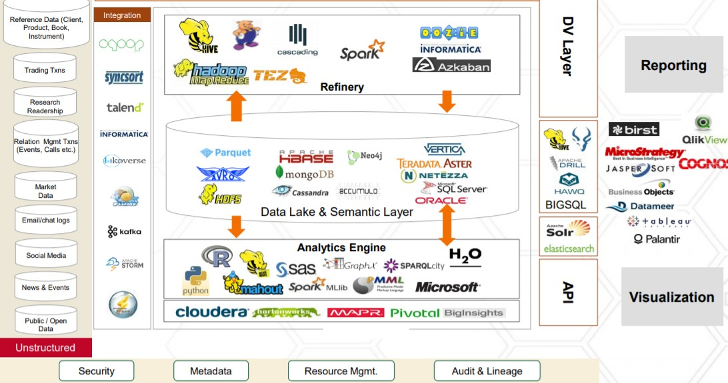

Slide 15
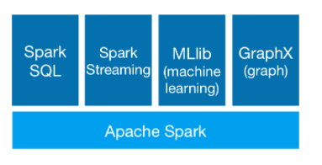
Apache Spark
It’s a frame work large scale data processing
Run programs up to 100x faster than Hadoop MapReduce in memory, or 10x faster on disk.
Easily write the applications using scala, java and python.
Spark runs on Hadoop, Mesos, standalone, or in the cloud. It can access diverse data sources including HDFS, Cassandra, HBase, and S3

Slide 16
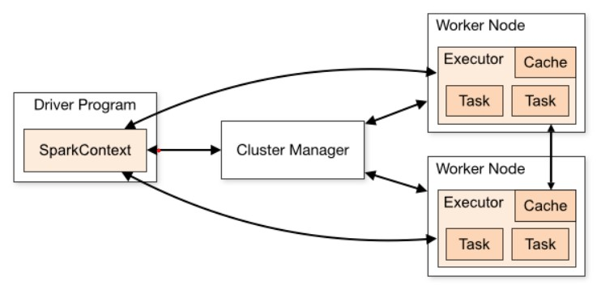
Spark Architecture

Slide 17
Spark Architecture
Spark Driver:
Driver program that runs on the master node of the spark cluster schedules the job execution and negotiates with the cluster manager.
It translates the RDD’s into the execution graph and splits the graph into multiple stages.
Driver program converts a user application into smaller execution units known as tasks. Tasks are then executed by the executors i.e. the worker processes which run individual tasks.
Spark Executor:
Executor performs all the data processing.
Reads from and Writes data to external sources.
Executor stores the computation results data in-memory, cache or on hard disk drives.
Interacts with the storage systems.

Slide 18
Submit Spark Job
Submitting Spark Applications:
./bin/spark-submit \
--class <main-class> \
--master <master-url> \
--deploy-mode <deploy-mode> \
--conf <key>=<value> \
<application-jar>
When a client submits a spark user application code, the driver implicitly converts the code containing transformations and actions into a logical directed acyclic graph (DAG).
it converts the logical DAG into physical execution plan with set of stages. After creating the physical execution plan, it creates small physical execution units referred to as tasks under each stage.
The driver program then talks to the cluster manager and negotiates for resources. Cluster manager then launches executors on the worker nodes

Slide 19
RDD - Resilient Distributed data Set
It provides fault tolerance through lineage graph, helps recomputed any missing or damaged partitions because of node failures
Apache Spark RDD supports two types of Operations-Transformations , Actions
RDDs are created in 2 ways.
Hadoop Datasets which are created from the files stored on HDFS .
val firstRDD = sc.textFile(“helloworld.txt")
Parallelized collections which are based on existing Scala collections
val data = Array(1, 2, 3, 4, 5)
val distData = sc.parallelize(data)

Slide 20
RDD – Transformations & Actions
Spark Transformation is a function that produces new RDD from the existing RDDs and built an RDD lineage, It is a logical execution plan.
In Narrow transformation, all the elements that are required to compute the records in single partition live in the single partition of parent RDD.
Narrow transformations are the result of map(), filter().
Wide transformation, all the elements that are required to compute the records in the single partition may live in many partitions of parent RDD.
Wide transformations are the result of groupbyKey() and reducebyKey(),join ().
Spark actions are count , collect, top, reduce and fold.

Slide 21
Data Frame & Data Set
Data Frame provides a domain-specific language for structured data manipulation.
A Data Frame is a distributed collection of data organized into named column
It is equivalent to a relational table in SQL used for storing data into tables.
Registering a Data Frame as a table allows you to run SQL queries over its data.
Datasets in Apache Spark are an extension of DataFrame API which provides type-safe, object-oriented programming interface
Dataset efficiently processes structured and unstructured data.
Data sets provides compile-time type safety
Dataset APIs is currently only available in Scala and Java. Spark version 2.1.1 does not support Python and R.

Slide 22

Tune your spark Job

Slide 23


Slide 24
Thank You!

